Slide 1
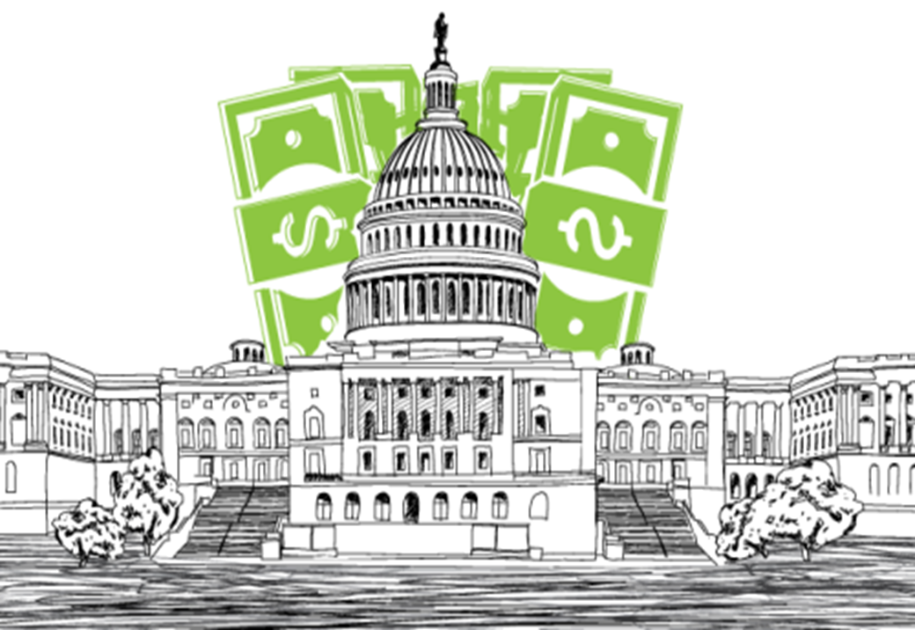

US Federal Campaign Finance Data [1990–2016] Analysis using Apache Spark

Slide 2


Introduction
Data Context
The campaign finance data for all US federal elections (including the every-2-year congressional and every-4-year presidential) from 1990 to 2016.
It includes candidate data, PAC data, individual contribution data, PAC to PAC contribution data, and PAC to candidate contribution data, along with political party, industry, sector, and geographical information for the contributions.

Slide 3
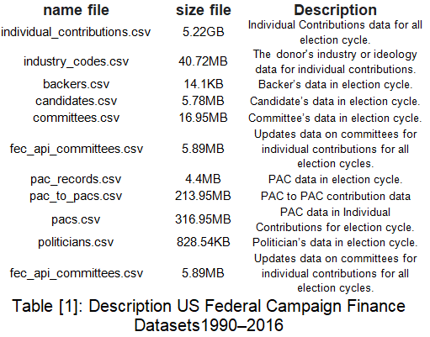
Data Organisation
The data is available in a CSV document.
It is 10 csv files for US Federal Campaign individual contributions as shown in the table [1]

Slide 4

Business Value
How do the individual contributions of each course evolve over time?
How are contributions affected by a presidential election year versus a midterm election?
How does the industry or ideology of the donor influence individual contributions?

Slide 5
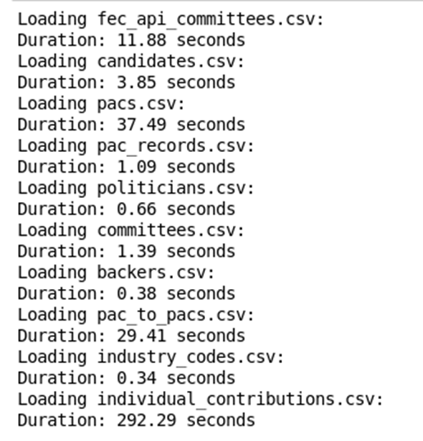
Data Process
Loading the datasets in the Spark dataframe
Check the null values and duplicated rows.
Data Cleaning: individual contributions dataset

Slide 6

data clean
To solve the null values, we split this large dataset into two datasets:
The individual contribution dataset doesn't have the committee ID number for the intermediary party to earmark contributions.
The individual contributions dataset has the committee ID number for the intermediary party to earmark contributions.
drop some columns such as "ult_org", "other_id”
fill the null values by the Fliter method with ‘unknown’
drop missing value ‘X4000' in the “cycle” column.
change the type of “cycle” column from a string to an integer

Slide 7


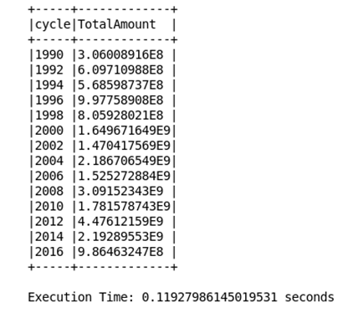
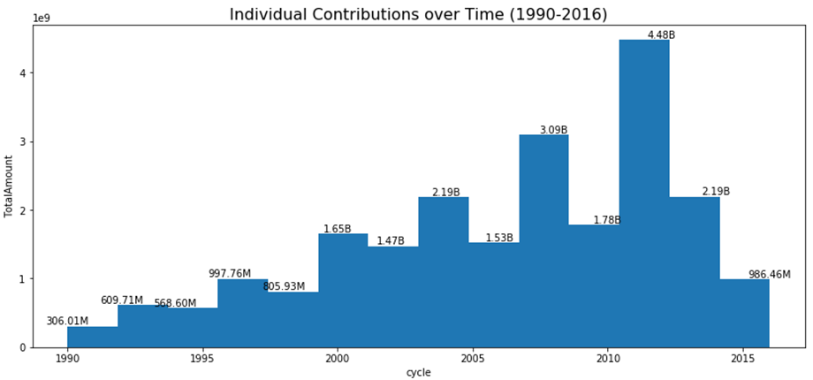

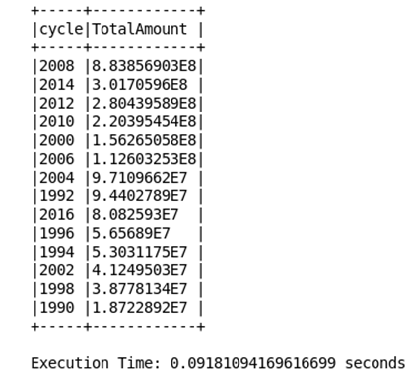
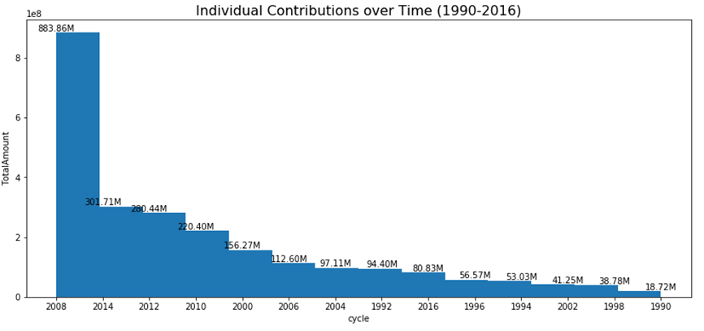
Data Analysis
How do individual contributions for each cycle evolve over time?
Total amount of individual contributions
that that don’t have the intermediary
party's earmarked contributions
over time (1990-2016).
Total amount of individual contributions that that have the intermediary party's earmarked contributions over time (1990-2016).

Slide 8
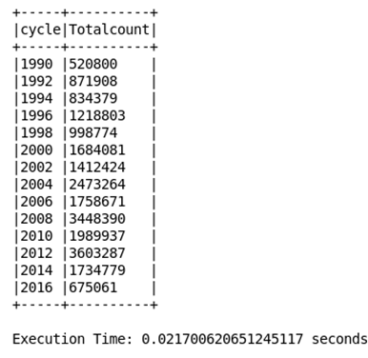
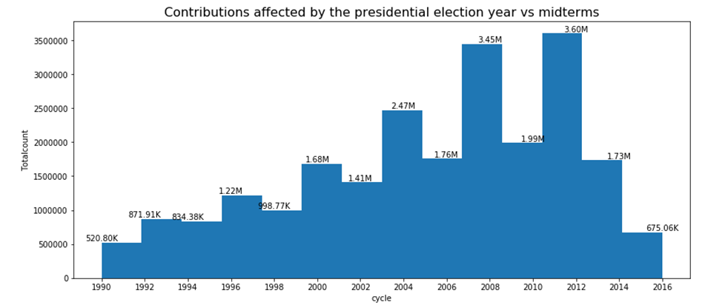
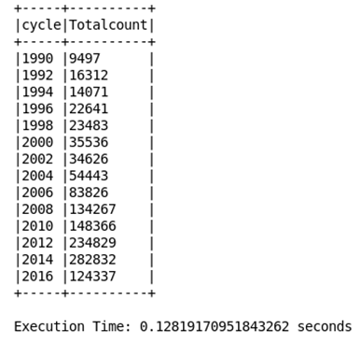
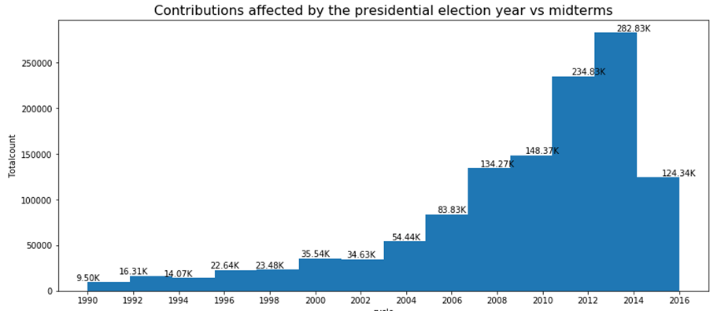
Data Analysis
How are contributions affected by the presidential election year vs midterms?
Total count of individual contributions that that don’t have the intermediary party's earmarked contributions over time (1990-2016).
Total count of individual contributions that that have the intermediary party's earmarked contributions over time (1990-2016)

Slide 9
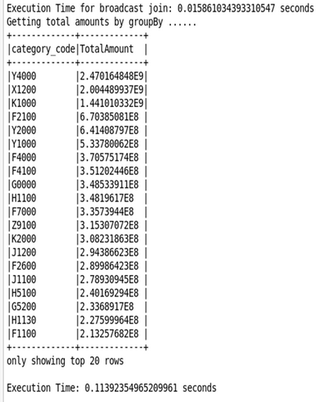
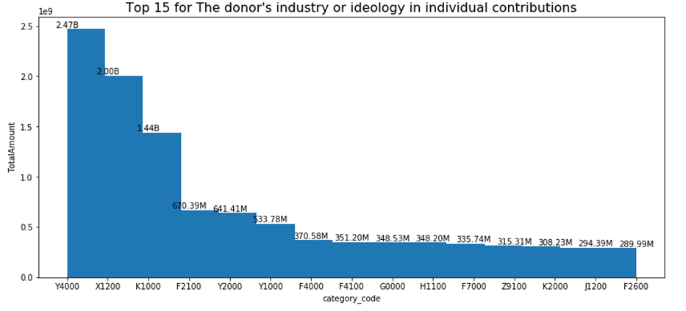
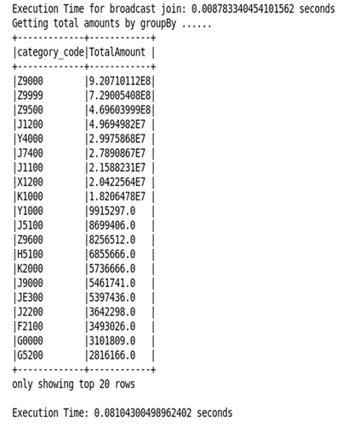
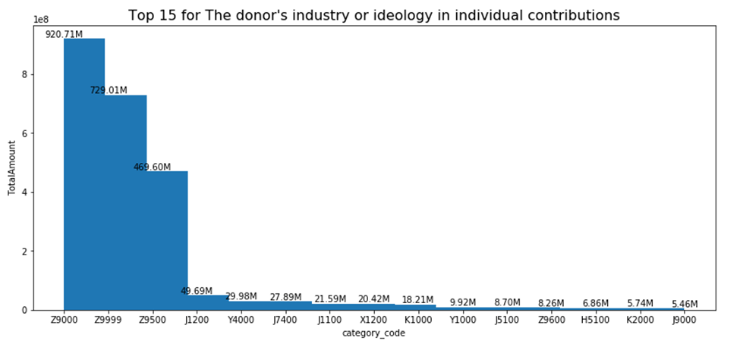
Data Analysis
How does a donor's industry or ideology affect individual contributions?
The total amounts for the donor's industry or ideology in individual contributions that don't have the intermediary party's earmarked contributions
The total amounts for the donor's industry or ideology in individual contributions that have the intermediary party's earmarked contributions

Slide 10
Performance optimization for Spark's core functionalities
The techniques to optimize the Spark's core functionalities such Aggregations function, Joins, Filtering, Sorting, Grouping by, and others on large dataset a ‘individual_contributions.csv (5.22GB)’
A Spark DataFrame (`inferSchema=True`)
Allocate more memory to Spark by adjusting the `spark.driver.memory` and `spark.executor.memory` by 8 gigabytes.
Use repartitioning, caching, and ordering to help optimize the performance of the operations.
Change the partition number

Slide 11
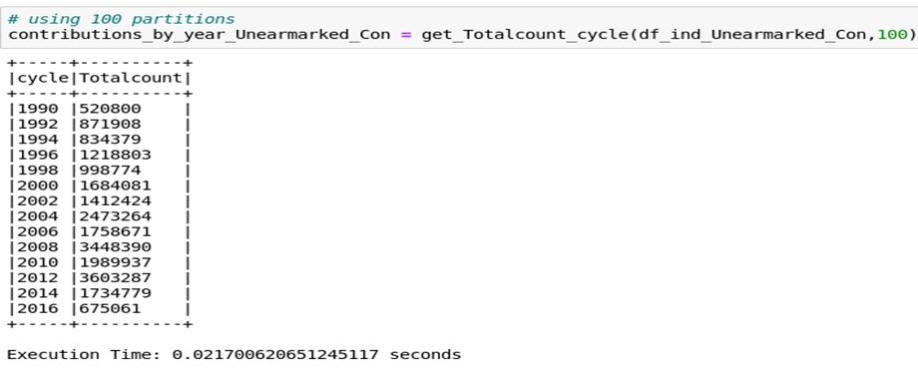
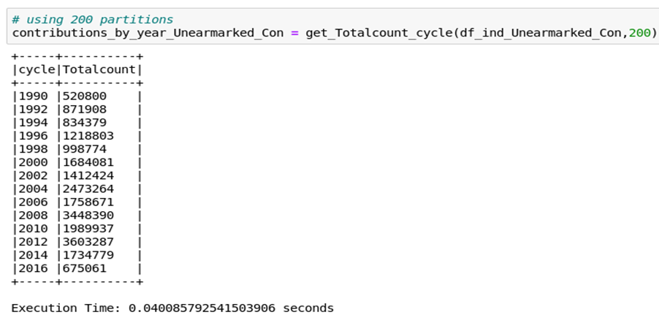
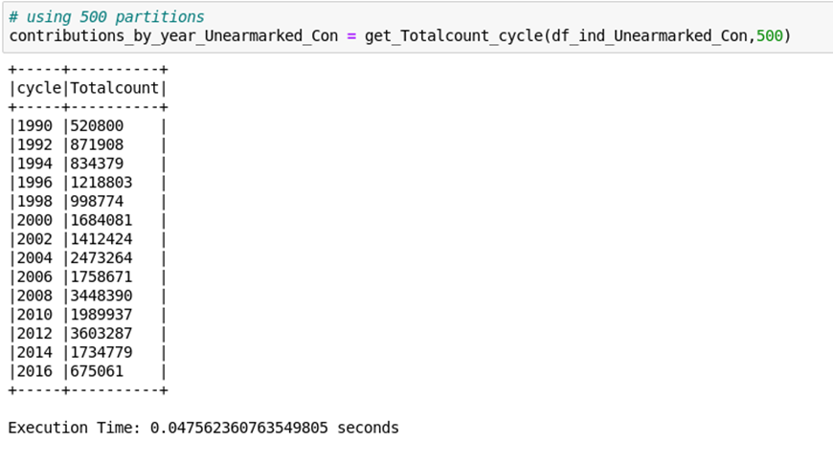
Performance optimization for Spark's core functionalities
Change the partition numbers to improve the Performance (100, 200, 500)

Slide 12
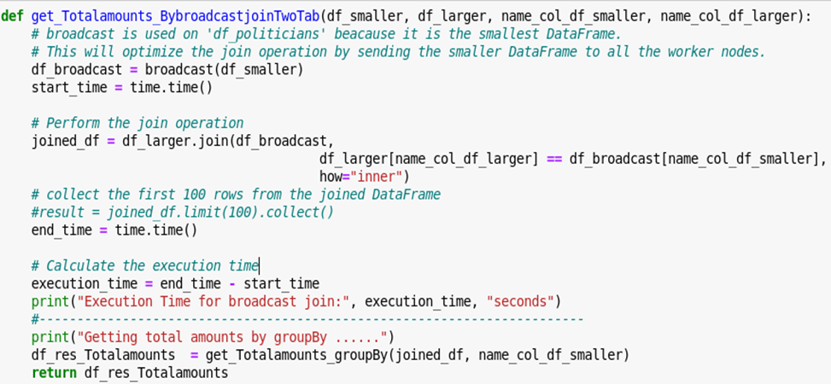
Performance optimization for Spark's core functionalities
use The `broadcast` function is used to optimize the join operation by sending the smaller DataFrame (`df_smaller`) to all worker nodes.

Slide 13
Performance optimization for Spark's core functionalities
The benefits of the `inner` join:
Efficient Data Filtering
Accurate Results
Improved Performance
Simplified Analysis

Slide 14
Thank you

